Slide 1

Design elements for network diagrams
CS Sprint 1 | Final Project

Slide 2
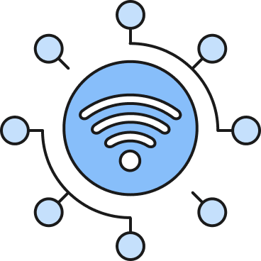



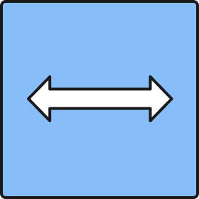
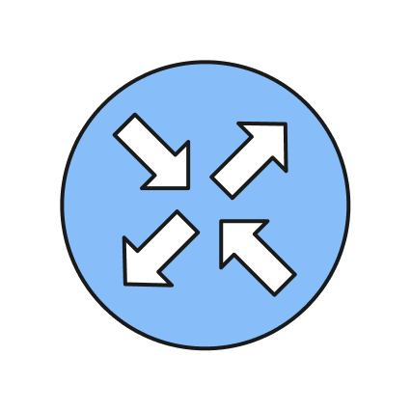


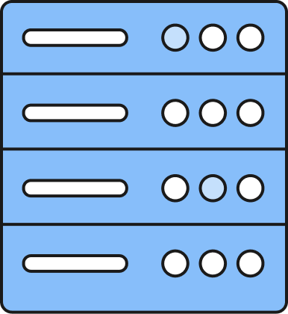
Network Redesign
Building A: Building B: Building C: Building D:
Manufacturing Parts Storage Office Staff IT Staff

Slide 3
- Added mesh topology to reduce interception chances, ensure data arrives correctly, and make sure no singular failure brings down the network.
- Added high speed connections to make sure routers are capable of handling the speeds.
- Added network observability to enable that the network performance can be monitored and analyzed properly.
- Added a firewall because of the security concerns of the employees.
- Added a WLAN because it provides greater employee mobility, better collaboration, reduced costs by cutting down on cabling, streamlined network management, increased flexibility to accommodate changing space demands, and seamless customer connectivity in certain environments—all contributing to improved business efficiency and productivity.

Slide 4
Instructions for the template
Do not change this file!
Create a copy of this file.
Use the elements from this file for your “Tempus Fugit” Project.
If you’ve deleted any icons or slides from your own copy, you can easily copy and paste necessary slides from here.
When you paste any text from another source, please use the “match destination formatting” option to keep your project’s style consistent.
Enjoy!

Slide 5
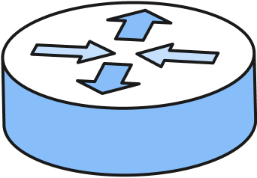
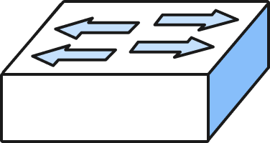
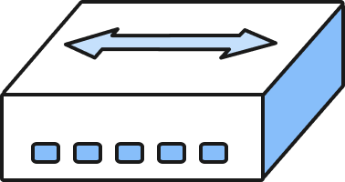
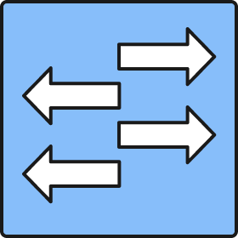

Devices
Router
Switch
Hub
If you need to make a complicated design, use these simplified icons
to keep the diagram clean and readable

Slide 6
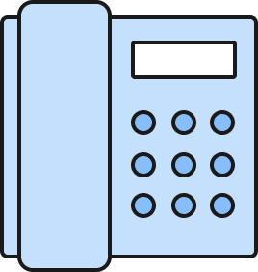
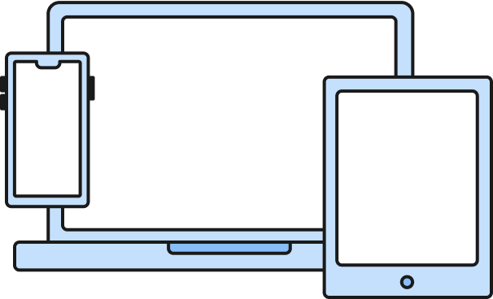
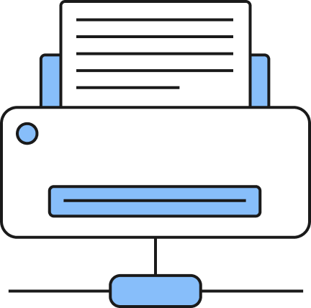
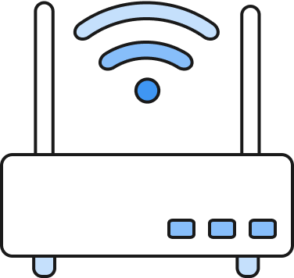
Devices
Phone
User Devices
Firewall
Wi-Fi access point
Printer

Slide 7
Topologies
Ring topology
Bus topology
Star topology

Slide 8
Topologies
Mesh topology
Hub-and-Spoke topology

Slide 9
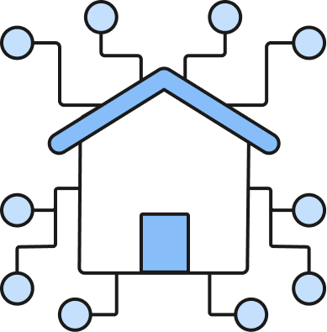
Area Networks
Internet (WAN)
Local Network
(LAN)
Wireless Network
(WLAN)
When you need to create connections between the networks, please use
the following types of lines:
Wired network for WAN
Wired network for LAN
Wireless network for WLAN

Slide 10
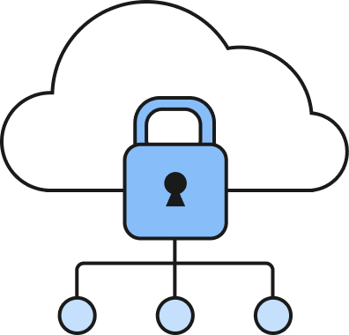
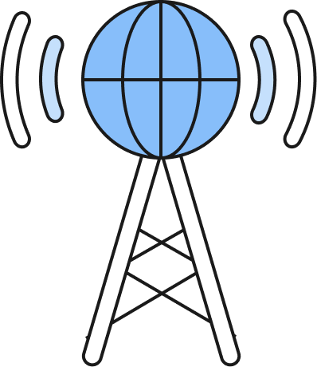
Service Providers
ISP
Data Center
Cloud Service Provider

Slide 11



Continuous Monitoring
Network Observability
Endpoint Detection
& Response (EDR)
Vulnerability Scan
No visibility into network

Slide 12

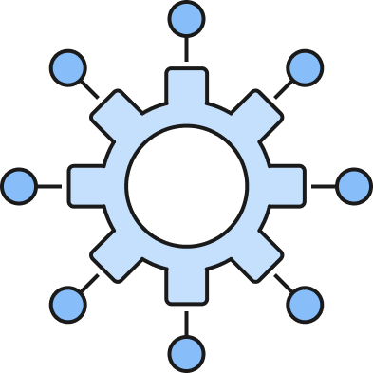
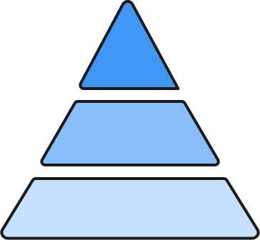
Architectures
Monolithic ERP
(Architecture)
Three-tier
(Architecture)
Cloud microservices
(Architecture)

Slide 13
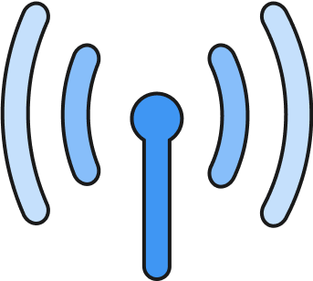

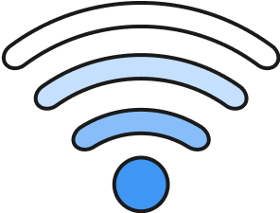
Connection Types
Wired connections
Wireless connections
High-speed Connection
Low-speed Connection
Wi-Fi Connection
Cellular Connection

